Slide 1




Binding Lists in WPF
Svetlin Nakov
Manager Technical Training
www.nakov.com
Telerik Corporation
www.telerik.com

Slide 2

Table of Contents
Complex Binding in WPF
Accessing the "SelectedItem"
Using DisplayMemberPath and ValueMemberPath
Using Look-up Bindings
Using Data Templates
Sorting, Filtering and Grouping Items from a Collection View

Slide 3

Table of Contents (2)
Master-detail Binding
Hierarchical Binding

Slide 4


Complex Data Binding
Binding to a Collection of Items

Slide 5
Complex Binding
Binding to a list data source is exactly the same way as if we were binding to a single object data source
// Create an alias for a generic type so that we
// can create a list of Person objects in XAML
class People : List<Person> { }
<!-- Declaring a collection in XAML -->
<local:People x:Key="Family">
<local:Person Name="Tom" Age="11" />
<local:Person Name="John" Age="12" />
<local:Person Name="Melissa" Age="38" />
</local:People>

Slide 6
Complex Binding (2)
<Grid DataContext="{StaticResource Family}">
…
<TextBlock …>Name:</TextBlock>
<TextBox Text="{Binding Path=Name}" … />
<TextBox Text="{Binding Path=Age}"
Foreground="{Binding Path=Age, Converter=…}"
…
/>
Each TextBox can be bound to a property from only a single Person object
In this example the TextBox will be bound to the first item in the collection ( i.e. "Tom")

Slide 7


Complex Data Binding
Live Demo

Slide 8

Accessing the "Current Item"

Slide 9
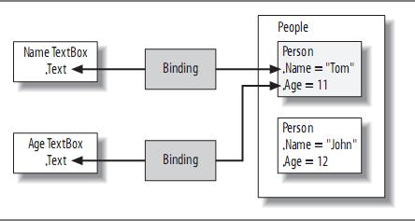
Accessing the "Current Item"
The text box properties can be bound to only a single object at a time
The binding engine is giving them the current item in the list of objects

Slide 10
Accessing the "Current Item" (3)
Collection view in WPF
A mediator between the data bound control and the collection of items
Accessed through CollectionViewSource
The job of the collection view is to provide services on top of the data
Control of the current item
Sorting
Filtering
Grouping

Slide 11
Accessing the "Current Item" (2)
Getting the current item of bound collection:
public partial class MainWindow : Window {
…
private void BirthdayButton_Click(object sender,
RoutedEventArgs e)
{
People people = (People)this.FindResource("Family");
ICollectionView view =
CollectionViewSource.GetDefaultView(people);
Person person = (Person)view.CurrentItem;
++person.Age;
MessageBox.Show(person.Age.ToString());
}
}

Slide 12
Navigating Between Items
We can change which item is current
Using the MoveCurrentTo(…) methods of the ICollectionView interface
ICollectionView GetFamilyView()
{
People people =(People)this.FindResource("Family");
return CollectionViewSource.GetDefaultView(people);
}
private void buttonBack_Click(object sender,
RoutedEventArgs e)
{
ICollectionView view = GetFamilyView();
view.MoveCurrentToPrevious();
if (view.IsCurrentBeforeFirst)
view.MoveCurrentToFirst();
}

Slide 13

Navigating Between Items
Live Demo

Slide 14
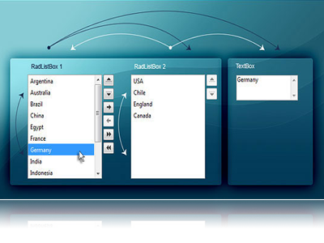
Binding List Controls
DisplayMemberPath and SelectedValuePath

Slide 15
Binding List Controls
List controls like ListBox and ComboBox display multiple items at a time
Can be bound to a collection in the DataContext
Can keep track of the current item
When binding the DisplayMemberPath specifies the property to be displayed
The SelectedValuePath specifies the property to be used as selected value (some ID)

Slide 16

DisplayMemberPath
If we want to show every object of the Person class and display one of its properties
The ListBox class provides the DisplayMemberPath property
<ListBox ItemsSource="{Binding}"
DisplayMemberPath="Name"
IsSynchronizedWithCurrentItem="True"
/>
<!--The result is-->

Slide 17
SelectedValuePath
The ItemsControl class provides a path to describe the selected value of a piece of data
Data which is often used when the selection changes or an item is double-clicked
<ListBox Name="ListBoxPeople" ItemsSource="{Binding}"
DisplayMemberPath="Name" SelectedValuePath="Age" />
private void ListBoxPeople_SelectionChanged(
object sender, SelectionChangedEventArgs e)
{
int index = ListBoxPerson.SelectedIndex;
if (index < 0) { return; }
Person item = (Person) ListBoxPerson.SelectedItem;
int value = (int) ListBoxPerson.SelectedValue; …
}

Slide 18
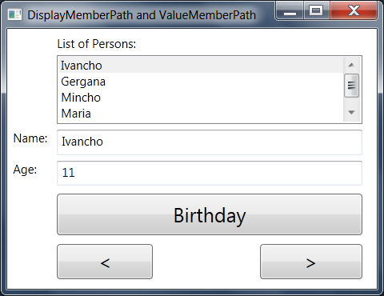
DisplayMemberPath and SelectedValuePath
Live Demo

Slide 19
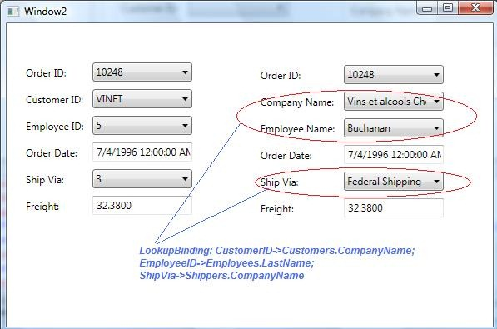
Using Look-up Bindings

Slide 20
Using Look-up Bindings
We want to provide a UI that maps numbers to their textual representation in English
We must construct a NamedAge type for use in populating a look-up table
public class NamedAge
{
public string NameForAge { get; set; }
public int AgeId { get; set; }
}
class NamedAges : List<NamedAge> { }

Slide 21
Using Look-up Bindings (2)
Populate the table for looking up
The final step is the bit of binding that tells the ComboBox control where to get the currently selected value
<local:NamedAges x:Key="NamedAgeLookup">
<local:NamedAge NameForAge="zero" AgeId="0" />
<local:NamedAge NameForAge="one" AgeId="1" />
</local:NamedAges>
<ComboBox Name="ComboBoxNumbers" ItemsSource=
"{Binding Source={StaticResource NamedAgeLookup}}"
DisplayMemberPath="NameForAge"
SelectedValuePath="AgeId"
SelectedValue="{Binding Path=Age}" />

Slide 22

Using Look-up Bindings
Live Demo

Slide 23
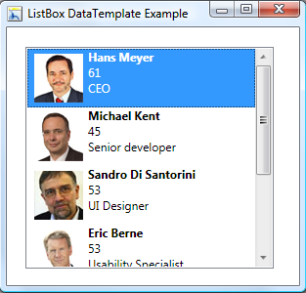
Using Data Templates

Slide 24
Using Data Templates
Data templates allow displaying more than one property from a custom class
A data template is a tree of elements to expand in a particular context
For example, for each Person object, you might like to be able to concatenate the name and age together
This is a logical template that looks like this
Name (age:Age)

Slide 25
Using Data Templates (2)
To define this template for items in the ListBox, we create a DataTemplate element
<ListBox ItemsSource="{Binding}">
<ListBox.ItemTemplate>
<DataTemplate>
<TextBlock>
<TextBlock Text="{Binding Path=Name}" />
(age:
<TextBlock Text="{Binding Path=Age}"
Foreground="{Binding Path=Age,
Converter={StaticResource ageConverter}}" />)
</TextBlock>
</DataTemplate>
</ListBox.ItemTemplate>
</ListBox>

Slide 26
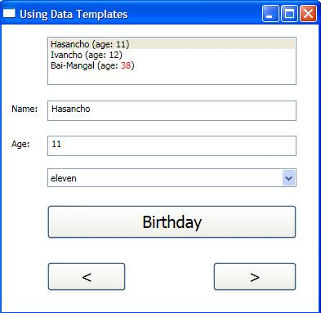
Using Data Templates (2)
The ListBox control has an ItemTemplate property
Accepts an instance of the DataTemplate class
The ListBox shows all the items in the collection

Slide 27
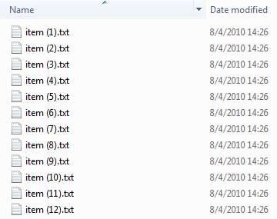

Sorting Items

Slide 28
Sorting Items
The view allows us to do a number of things to the data before it’s displayed
Including changing the order in which the data is shown
The simplest way to sort is by manipulating the SortDescriptions property of the view
Also we can provide the view with a custom sorting by implementing IComparer

Slide 29
Sorting Items (2)
Sorting items view in WPF:
private void buttonSort_Click
(object sender, RoutedEventArgs e)
{
ICollectionView view = GetFamilyView();
if (view.SortDescriptions.Count == 0)
{
view.SortDescriptions.Add(
new SortDescription("Name",
ListSortDirection.Ascending));
view.SortDescriptions.Add(
new SortDescription("Age",
ListSortDirection.Descending));
}
else
view.SortDescriptions.Clear();
}

Slide 30

Sorting Items
Live Demo

Slide 31
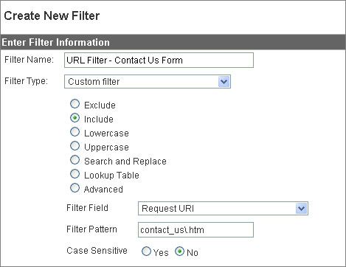
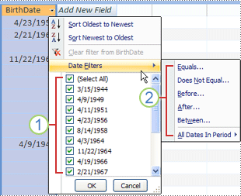
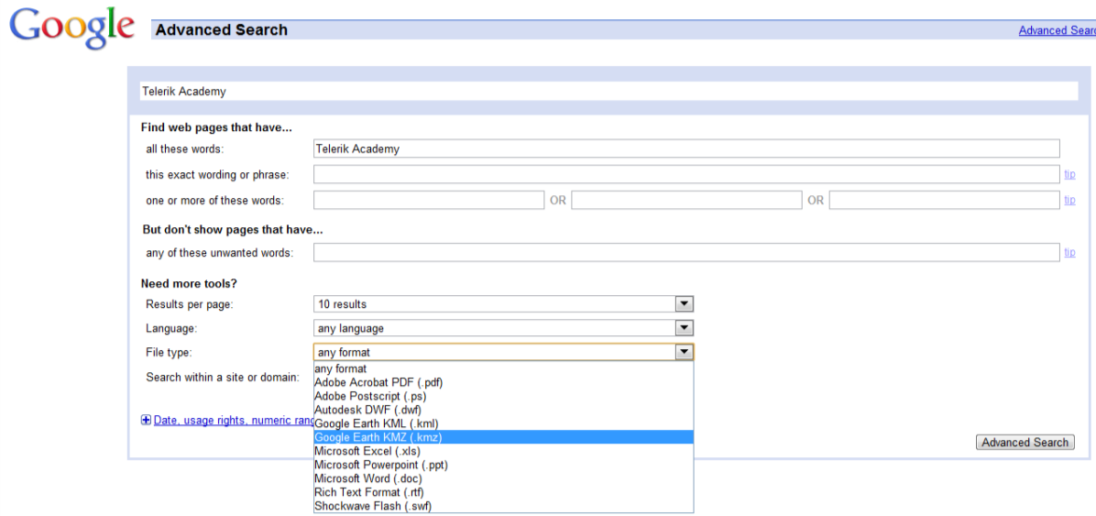
Filtering

Slide 32
Filtering
If we want to filter the objects from the view by some criteria
We need to feed the view an implementation of the Predicate<object> delegate
Takes a single object parameter and returns a Boolean
private void buttonFilter_Click(object sender,
RoutedEventArgs e)
{
ICollectionView view = GetFamilyView();
// the example continues

Slide 33
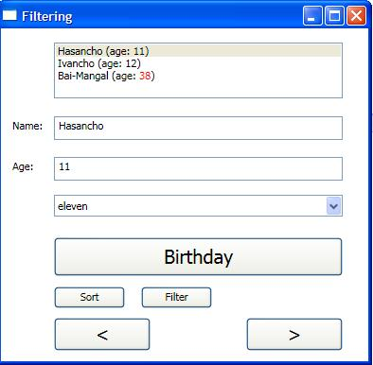
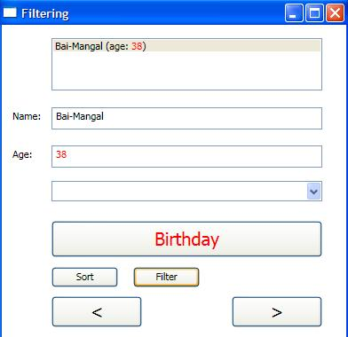
Filtering (2)
if (view.Filter == null)
{
view.Filter = delegate(object item)
{
return ((Person)item).Age >= 25;
};
}
else { view.Filter = null; } }
// The result is:

Slide 34
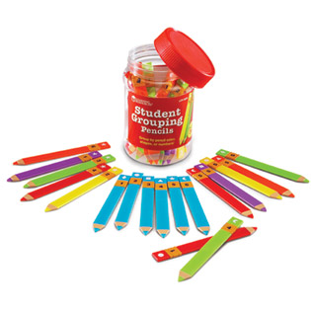
Grouping

Slide 35
Grouping
To set up grouping
Establish the groups you would like to use
Manipulating the GroupDescriptions collection on your view
if (view.GroupDescriptions.Count == 0)
{
view.GroupDescriptions.Add(
new PropertyGroupDescription("Age"));
}
else
{
view.GroupDescriptions.Clear();
}

Slide 36
Grouping (2)
The PropertyGroupDescription object
Takes the name of the property you would like to use for grouping
GroupStyle
Collection of group visualization related information
<ListBox … ItemsSource="{Binding}" >
<ListBox.GroupStyle>
<x:Static Member="GroupStyle.Default" />
</ListBox.GroupStyle>
</ListBox>

Slide 37
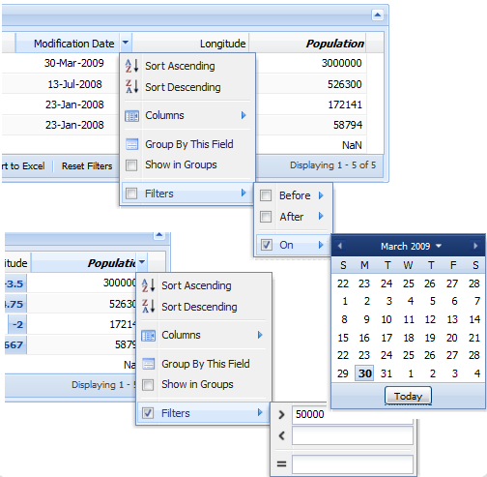
Filtering and Grouping
Live Demo

Slide 38
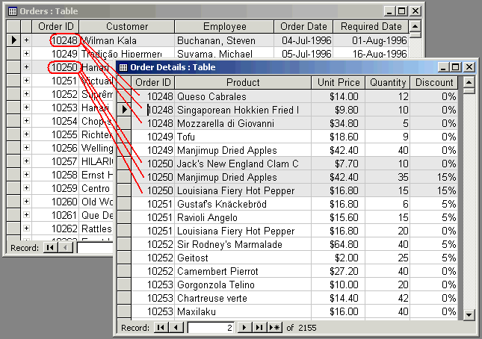
Master-Detail Binding

Slide 39
Master-Details Binding
Master-details binding means to bind two related lists
Selecting a row in the first list shows its detail rows in the second list
You need to have a parent data object that provides a collection of related child objects
Master-details binding is a form of filtering
Where the selection in the master list acts as filtering parameter for the associated detail list

Slide 40
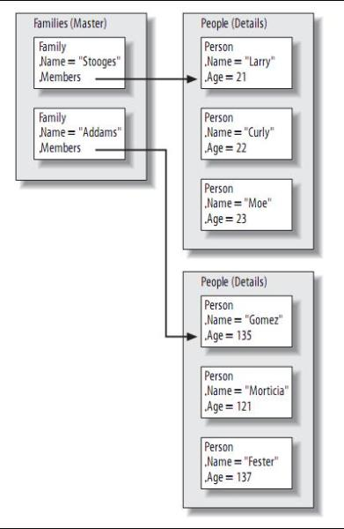
Master-Details Binding (2)
In previous example we have families and people
Instances of Families, Family, People, and Person looked like this
The Families collection is the master data
It is holding instances of the Family class
Each of which holds Members property of type People
Which holds the detail Person

Slide 41
Master-Details Binding – Example
Declaring master-detail data:
<Window.Resources>
<local:Families x:Key="Families">
<local:Family FamilyName="Piyandetata">
<local:Family.Members>
<local:People>
<local:Person Name="Joro Vodkata" Age="21" />
…
</local:People>
</local:Family.Members>
</local:Family>
<local:Family FamilyName="Addams">
<local:Family.Members>
<local:People>
<local:Person Name="Uncle Fester" Age="135" />
…
</local:Families>
</Window.Resources>

Slide 42
Master-Details Binding – Example (2)
Binding to master Family data:
<Window.Resources>
<local:Families x:Key="Families">…</local:Families>
</Window.Resources>
<Grid DataContext="{StaticResource Families}">
…
<!-- Families Column -->
<TextBlock Grid.Row="0"
Grid.Column="0">Families:</TextBlock>
<ListBox Grid.Row="1" Grid.Column="0"
IsSynchronizedWithCurrentItem="True"
ItemsSource="{Binding}">
<ListBox.ItemTemplate>
<DataTemplate>
<TextBlock Text="{Binding Path=FamilyName}" />
</DataTemplate>
</ListBox.ItemTemplate>
</ListBox>

Slide 43
Master-Details Binding – Example (3)
Binding to detail Person data:
<Grid DataContext="{StaticResource Families}"> ...
… <!-- Members Column -->
<StackPanel Grid.Row="0" Grid.Column="1"
Orientation="Horizontal">
<TextBlock Text="{Binding Path=FamilyName}" />
<TextBlock Text=" Family Members:" />
</StackPanel>
<ListBox Grid.Row="1" Grid.Column="1"
IsSynchronizedWithCurrentItem="True"
ItemsSource="{Binding Path=Members}" >
<ListBox.ItemTemplate>
<DataTemplate>
<StackPanel Orientation="Horizontal">
<TextBlock Text="{Binding Path=Name}" />
<TextBlock Text=" (age: " />
<TextBlock Text="{Binding Path=Age}" />
<TextBlock Text=" )" /> …

Slide 44
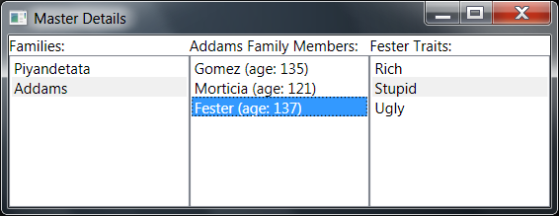
Master-Details Binding
Live Demo

Slide 45
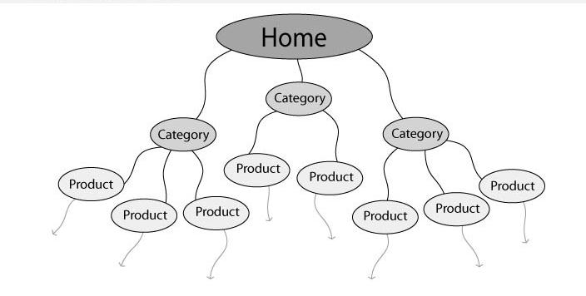
Hierarchical Binding

Slide 46
Hierarchical Binding
Hierarchical binding generally involves some number of levels, unknown until runtime
E.g. a tree of items, each with few child items
Control that can expand itself as appropriate, like a menu or a tree needs hierarchical binding
WPF has built-in support for hierarchical binding using a special kind of data template
Knows both how to display the current level of data and where to go for the next level

Slide 47

Hierarchical Binding (2)
Binding a TreeView control’s root item
Provide a data template
<DataTemplate DataType="{x:Type local:Family}">
<TextBlock Text="{Binding Path=FamilyName}" />
</DataTemplate>
</Window.Resources>
…
<TreeView DataContext="{StaticResource Families}">
<TreeViewItem ItemsSource="{Binding}"
Header="Families" />
</TreeView>

Slide 48
Hierarchical Binding (3)
HierarchicalDataTemplate element
Provides the ItemsSource property so that the tree can keep digging into the data
<HierarchicalDataTemplate DataType="{x:Type local:Family}"
ItemsSource="{Binding Path=Members}">
<TextBlock Text="{Binding Path=FamilyName}" />
</HierarchicalDataTemplate>
<HierarchicalDataTemplate DataType="{x:Type local:Person}"
ItemsSource="{Binding Path=Traits}">
<TextBlock>
<TextBlock Text="{Binding Path=Name}" />
(age: <TextBlock Text="{Binding Path=Age}" />)
</TextBlock>
</HierarchicalDataTemplate>

Slide 49
Binding Lists
?
?
?
?
?
Questions?
?
?
?
?
?
?
http://academy.telerik.com

Slide 50
Exercises
Write a program to manage a simple system with information about towns and countries. Each country is described by name, language, national flag and list of towns. Each town is described by name, population and country. You should create navigation over the towns and countries. Enable editing the information about them. Don't use list controls but only text boxes and simple binding
Rewrite the previous exercise using list controls.

Slide 51
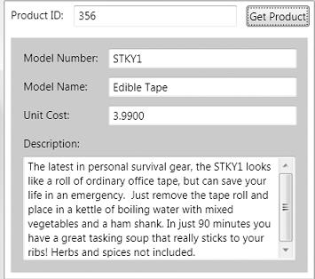
Exercises (2)
Create a database with two tables – Categories and Products. Each category has category name. Each product has category, model number, model name unit cost, and description. Consider the simple window look like the screenshot below:
Design a form to view products by ID and bind all controls to their relevant columns from the database tables.

Slide 52
Exercises (3)
Using complex data binding create a system, resembling the system from the first exercise (towns and countries). Add to the system a set of continents – each country is in one of them. Display data and enable navigation. Load and save the data in a XML file. Add sorting, filtering and grouping functions. Use master-details bindings.
Rewrite the previous exercise to use database and LINQ-to-SQL. Ensure all entities can be added / edited / deleted (continents, countries and towns).

